Slide 1

UNIT – IV
Cryptographic hash functions: Applications of cryptographic hash functions - Two simple hash functions - Requirements and security - Hash functions based on cipher block chaining - Secure Hash Algorithm (SHA) - SHA-3 - Message Authentication Codes (MAC): Message authentication requirements - Message authentication functions - Requirements for MAC - Security of MAC - HMAC - DAA and GCM - Key wrapping - Pseudorandom number generation using hash functions and MAC - Digital Signatures: Digital signatures - Elgamal digital signature scheme - Schnorr digital signature scheme - NIST, Elliptic curve and RSA-PSS digital signature algorithm | Transport level security: Web security considerations - Transport layer security - HTTPS - Secure shell - Electronic mail security: Internet mail architecture - Email formats - Email Threads and Comprehensive Email security - S/MIME - Pretty Good Service - DNSSEC - DNS based authentication of named entities - Sender policy framework - IP security: Overview - Policy - Encapsulating security payload - Combining security associations - Internet key exchange - Cryptographic suites
SASTRA DEEMED To Be UNIVERSITY

Slide 2
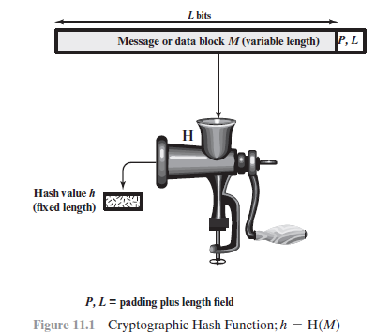
SASTRA DEEMED To Be UNIVERSITY

Slide 3
MAC Function vs Hash Function
MAC Function:
MAC= F_{KAB} (M)
Hash Function:
H(M) =h
h=Hash code / Message Digest

Slide 4
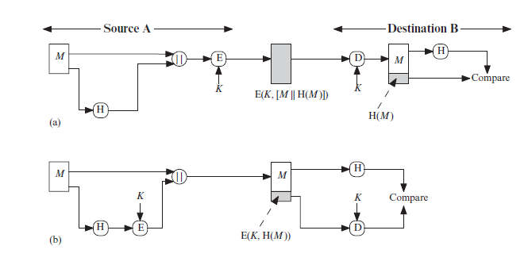
SASTRA DEEMED To Be UNIVERSITY

Slide 5
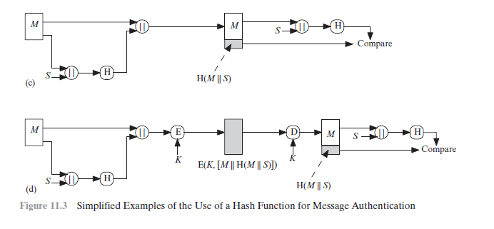
SASTRA DEEMED To Be UNIVERSITY

Slide 6
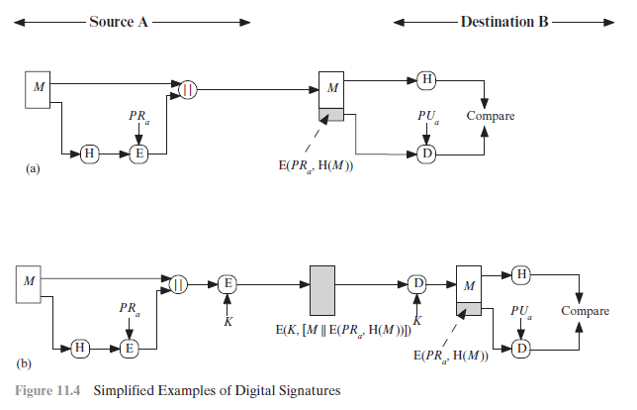
SASTRA DEEMED To Be UNIVERSITY

Slide 7
Requirements for Hash Functions
H can be applied to any sized message M
H produces fixed-length output h
It is easy to compute h=H(M) for any message M
For given h is infeasible to find x s.t. H(x)=h
  one-way property
Given x is infeasible to find y s.t. H(y)=H(x)
  weak collision resistance
It is infeasible to find any x,y s.t. H(y)=H(x)
  strong collision resistance
Notes:
These are the specifications for good hash functions. Essentially it must be extremely difficult to find 2 messages with the same hash, and the hash should not be related to the message in any obvious way (ie it should be a complex non-linear function of the message). There are quite a few similarities in the evolution of hash functions & block ciphers, and in the evolution of the design requirements on both.

Slide 8
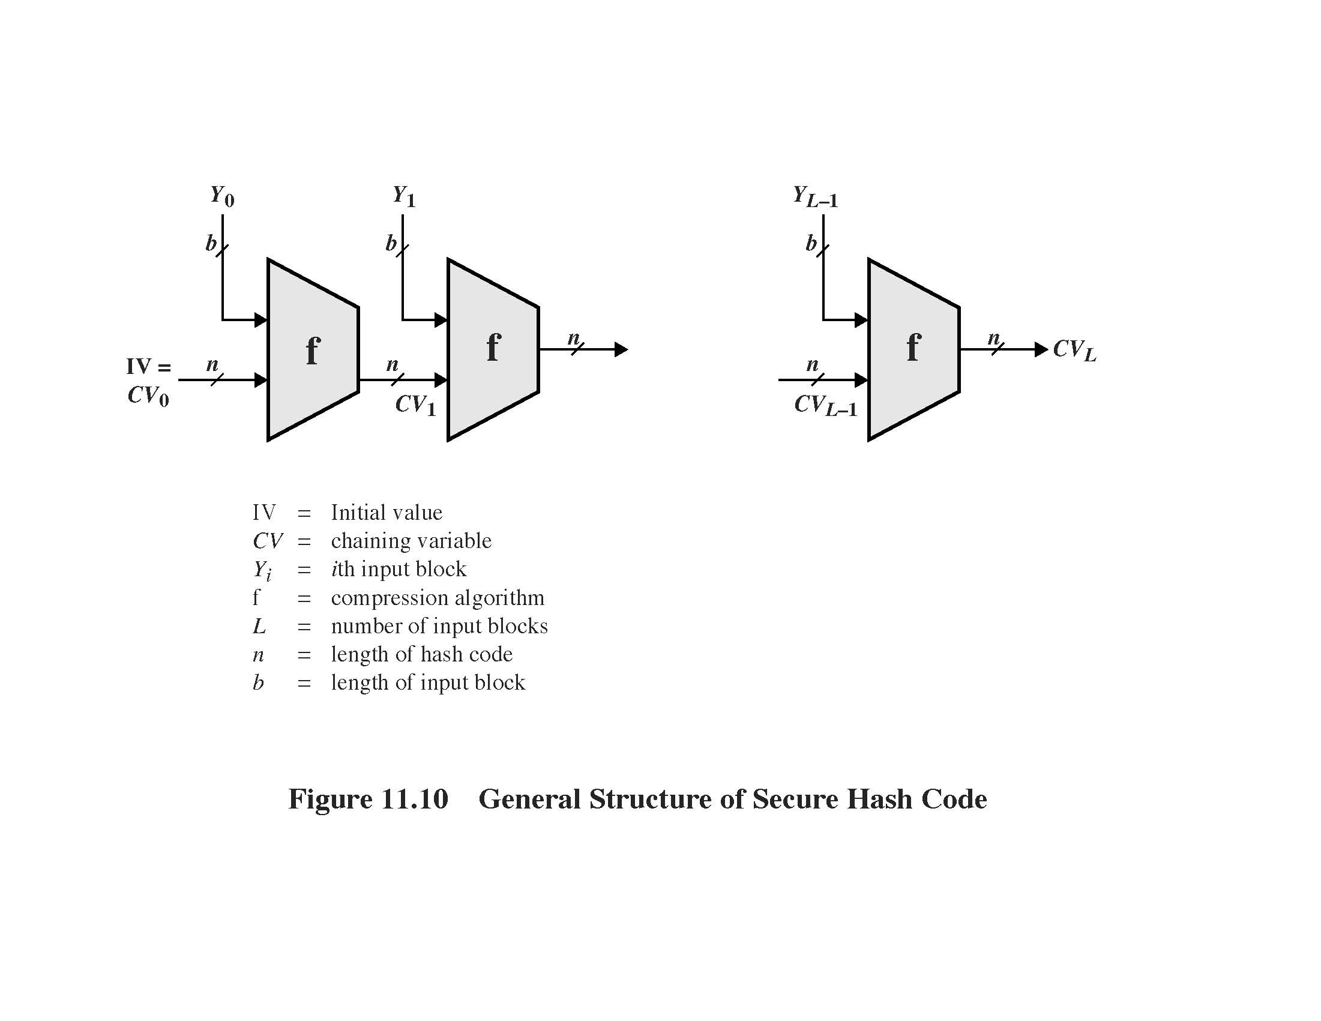
General Structure of Hash Function

Slide 9
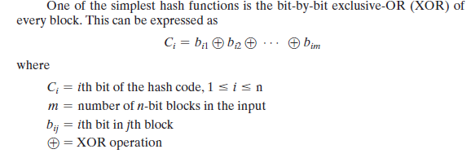
Two Simple Hash Functions
SASTRA DEEMED To Be UNIVERSITY

Slide 10

Rotated XOR
SASTRA DEEMED To Be UNIVERSITY

Slide 11
Secure Hash Algorithm (SHA)
Designed by NIST
Block Size - 1024 bit
produces a 512-bit hash value
  5 Steps:
  Append Padding bits
  Append Length
  Initialize MD Buffer
  Process 1024-bit block
  Output
Notes:
MD5 is the current, and very widely used, member of Rivest’s family of hash functions.

Slide 12
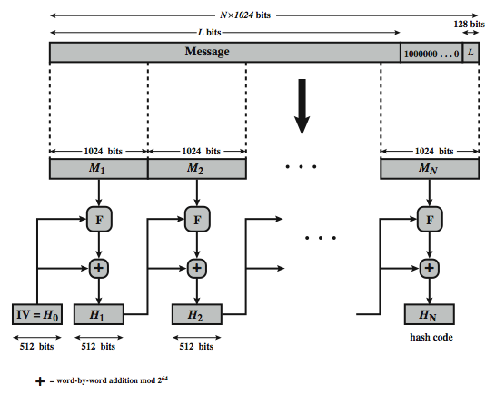
SHA-3 Overview

Slide 13
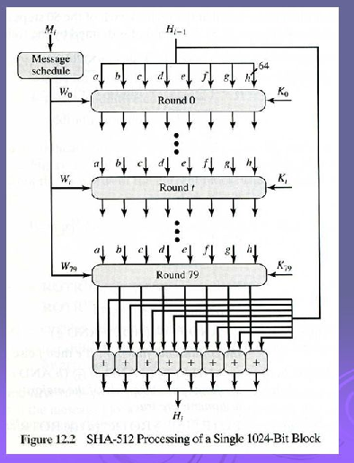

Slide 14
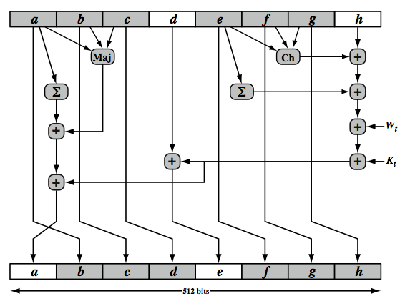
SHA-512 Round Function
Notes:
The structure of each of the 80 rounds is shown in Stallings Figure 11.10. Each 64-bit word is shuffled along one place, and in some cases manipulated using a series of simple logical functions (ANDs, NOTs, ORs, XORs, ROTates), in order to provide the avalanche & completeness properties of the hash function. The elements are:
Ch(e,f,g) = (e AND f) XOR (NOT e AND g)
Maj(a,b,c) = (a AND b) XOR (a AND c) XOR (b AND c)
∑(a) = ROTR(a,28) XOR ROTR(a,34) XOR ROTR(a,39)
∑(e) = ROTR(e,14) XOR ROTR(e,18) XOR ROTR(e,41)
+ = addition modulo 2^64
Kt = a 64-bit additive constant
Wt = a 64-bit word derived from the current 512-bit input block.
Six of the eight words of the output of the round function involve simply permutation (b, c, d, f, g, h) by means of rotation. This is indicated by shading in Figure 11.10. Only two of the output words (a, e) are generated by substitution. Word e is a function of input variables d, e, f, g, h, as well as the round word W t and the constant Kt. Word a is a function of all of the input variables, as well as the round word W t and the constant Kt.

Slide 15
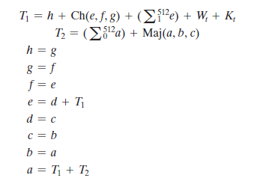
SASTRA DEEMED To Be UNIVERSITY

Slide 16
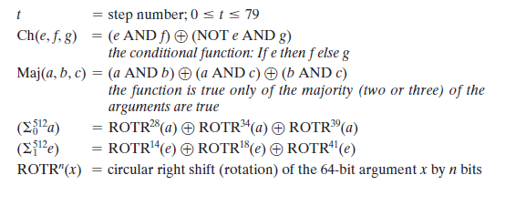
SASTRA DEEMED To Be UNIVERSITY

Slide 17
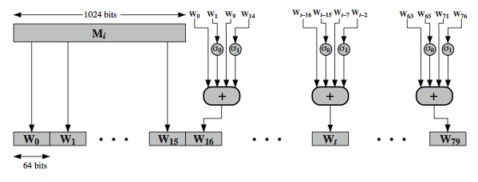

Creation of 80-word input
Notes:
Stallings Figure 11.11 illustrates how the 64-bit word values Wt are derived from the 1024-bit message. The first 16 values of Wt are taken directly from the 16 words of the current block. The remaining values are defined as a function of the earlier values using ROTates, SHIFTs and XORs as shown. The function elements are:
∂0(x) = ROTR(x,1) XOR ROTR(x,8) XOR SHR(x,7)
∂1(x) = ROTR(x,19) XOR ROTR(x,61) XOR SHR(x,6)
Thus, in the first 16 steps of processing, the value of W_{t} is equal to the corresponding word in the message block. For the remaining 64 steps, the value of W_{t} consists of the circular left shift by one bit of the XOR of four of the preceding values of W_{t}, with two of those values subjected to shift and rotate operations. This introduces a great deal of redundancy and interdependence into the message blocks that are compressed, which complicates the task of finding a different message block that maps to the same compression function output.
See text for details of an example based on one in FIPS 180.

Slide 18
Message Authentication Codes
SASTRA DEEMED To Be UNIVERSITY

Slide 19
Message Authentication Requirements
Disclosure: Release of message contents to any person or process not possessing the appropriate cryptographic key.
Traffic analysis: Discovery of the pattern of traffic between parties.
Masquerade: Insertion of messages into the network from a fraudulent source.
Content modification: Changes to the contents of a message, including insertion,
deletion, transposition, and modification.
Sequence modification: Any modification to a sequence of messages between
parties, including insertion, deletion, and reordering.
Timing modification: Delay or replay of messages.
Source repudiation: Denial of transmission of message by source.
Destination repudiation: Denial of receipt of message by destination.
SASTRA DEEMED To Be UNIVERSITY

Slide 20
Message Authentication Functions
■ Hash function: A function that maps a message of any length into a fixed-length hash value, which serves as the authenticator.
■ Message encryption: The ciphertext of the entire message serves as its authenticator.
■ Message authentication code (MAC): A function of the message and a secret key that produces a fixed-length value that serves as the authenticator
SASTRA DEEMED To Be UNIVERSITY

Slide 21
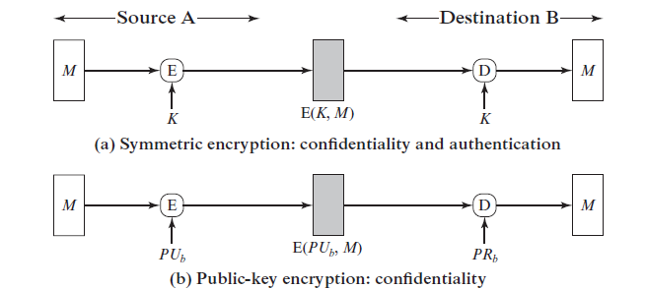
SASTRA DEEMED To Be UNIVERSITY

Slide 22
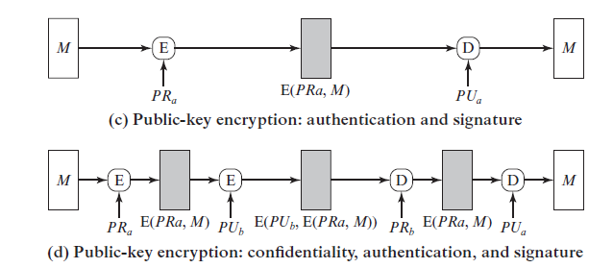
SASTRA DEEMED To Be UNIVERSITY

Slide 23

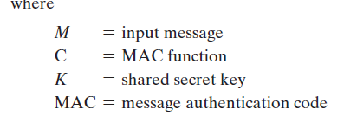
Message Authentication Codes
SASTRA DEEMED To Be UNIVERSITY

Slide 24
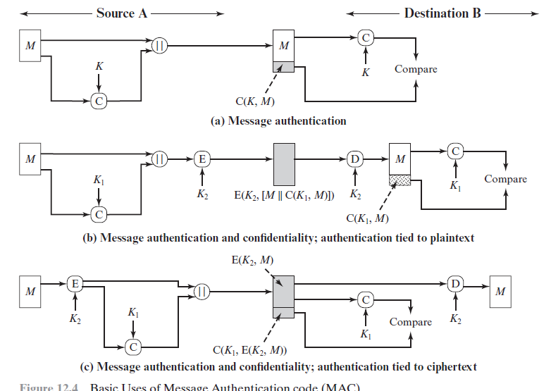
SASTRA DEEMED To Be UNIVERSITY

Slide 25
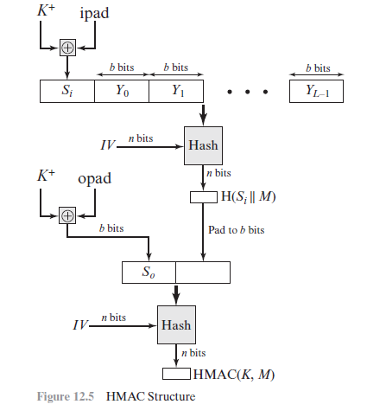

MACs based on Hash Function: HMAC
SASTRA DEEMED To Be UNIVERSITY

Slide 26
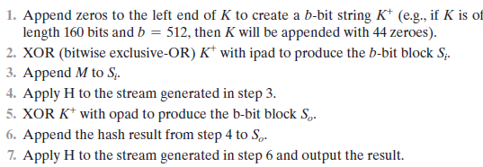
SASTRA DEEMED To Be UNIVERSITY

Slide 27
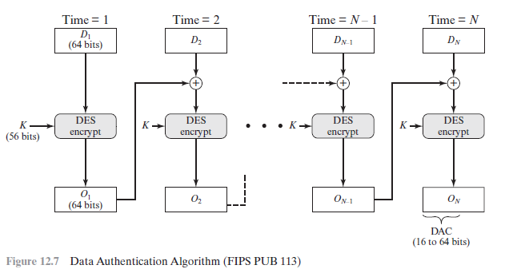
Data Authentication Algorithm
SASTRA DEEMED To Be UNIVERSITY

Slide 28
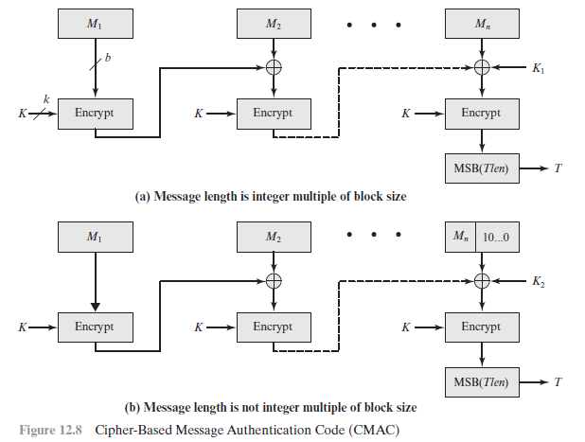
Cipher based Message Authentication Code(CMAC)
SASTRA DEEMED To Be UNIVERSITY

Slide 29
Authenticated Encryption
simultaneously protect confidentiality and authenticity of communications
  often required but usually separate
Approaches
  Hash-then-encrypt: E(K, (M || H(M))
  MAC-then-encrypt: E(K2, (M || MAC(K1, M))
  Encrypt-then-MAC: (C=E(K2, M), T=MAC(K1, C)
  Encrypt-and-MAC: (C=E(K2, M), T=MAC(K1, M)
Notes:
Authenticated encryption (AE) is a term used to describe encryption systems that simultaneously protect confidentiality and authenticity (integrity) of communications. Many applications and protocols require both forms of security, but until recently the two services have been designed separately. [BLAC05] discussed four common approaches to providing both confidentiality and encryption for a message M:
• HtE: Hash-then-encrypt. First compute the cryptographic hash function over M as h = H(M). Then encrypt the message plus hash function: E(K, (M || h)
• MtE: MAC-then-encrypt. Use two keys. First authenticate the plaintext by computing the MAC value as T = MAC(K1, M). Then encrypt the message plus tag: E(K2, (M || T) cf SSL/TLS
• EtM: Encrypt-then-MAC. Use two keys. First encrypt the message to yield the ciphertext C = E(K 2, M). Then authenticate the ciphertext with T = MAC(K1, C) to yield the pair (C, T) cf IPsec
• E&M: Encrypt-and-MAC. Use two keys. Encrypt the message to yield the ciphertext C = E(K 2, M). Authenticate the plaintext with T = MAC(K1, M) to yield the pair (C, T). These operations can be performed in either order. cf SSH
Both decryption and verification are straightforward for each approach. There are security vulnerabilities with all of these approaches.

Slide 30
Counter with Cipher Block Chaining-Message Authentication Code (CCM)
NIST standard
variation of encrypt-and-MAC approach
algorithmic ingredients
  AES encryption algorithm
  CTR mode of operation
  CMAC authentication algorithm
single key used for both encryption & MAC
Notes:
The CCM mode of operation was standardized by NIST specifically to support the security requirements of IEEE 802.11 WiFi wireless local area networks (Chapter 17), but can be used in any networking application requiring authenticated encryption. CCM is a variation of the encrypt-and-MAC approach to authenticated encryption. It is defined in NIST SP 800-38C. The key algorithmic ingredients of CCM are the AES encryption algorithm (Chapter 5), the CTR mode of operation (Chapter 6), and the CMAC authentication algorithm (Section 12.6). A single key K is used for both encryption and MAC algorithms.

Slide 31
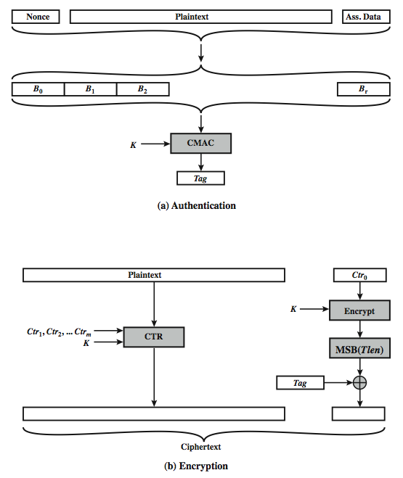
CCM Operation
Notes:
Stallings Figure 12.9 illustrates the operation of CCM. For authentication, the input includes the nonce, the associated data, and the plaintext. This input is formatted as a sequence of blocks B0 through Br. The first block contains the nonce plus some formatting bits that indicate the lengths of the N, A, and P elements. This is followed by zero or more blocks that contain A, followed by zero of more blocks that contain P. The resulting sequence of blocks serves as input to the CMAC algorithm, which produces a MAC value with length Tlen, which is less than or equal to the block length (Figure 12.9a). For encryption, a sequence of counters is generated that must be independent of the nonce. The authentication tag is encrypted in CTR mode using the single counter Ctr0. The Tlen most significant bits of the output are XORed with the tag to produce an encrypted tag. The remaining counters are used for the CTR mode encryption of the plaintext (Figure 6.7). The encrypted plaintext is concatenated with the encrypted tag to form the ciphertext output (Figure 12.9b). CCM is a relatively complex algorithm. Note that it requires two complete passes through the plaintext, once to generate the MAC value, and once for encryption. Further, the details of the specification require a tradeoff between the length of the nonce and the length of the tag, which is an unnecessary restriction. Also note that the encryption key is used twice with the CTR encryption mode, once to generate the tag and once to encrypt the plaintext plus tag. Whether these complexities add to the security of the algorithm is not clear. In any case, two analyses of the algorithm conclude that CCM provides a high level of security.

Slide 32
Galois/Counter Mode (GCM)
NIST standard
message is encrypted in variant of CTR
ciphertext multiplied with key & length over in (2¹²⁸) to generate authenticator tag
uses two functions:
  GHASH - a keyed hash function
  GCTR - CTR mode with incremented counter
Notes:
The Galois/Counter Mode (GCM) mode of operation, standardized by NIST in NIST SP 800-38D, is designed to be parallelizable so that it can provide high throughput with low cost and low latency. In essence, the message is encrypted in variant of CTR mode. The resulting ciphertext is multiplied with key material and message length information over GF(2¹²⁸) to generate the authenticator tag. The standard also specifies a mode of operation that supplies the MAC only, known as GMAC. The GCM mode makes use of two functions: GHASH, which is a keyed hash function: and GCTR, which is essentially the CTR mode with the counters determined by a simple increment by one operation.

Slide 33
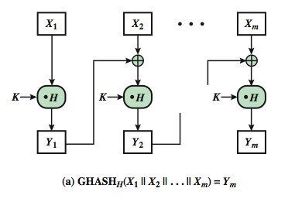
GCM Functions
Notes:
GHASH_{H}(X) takes a input the hash key H and a bit string X such that len(X) = 128m bits for some positive integer m and produces a 128-bit MAC value. The function may be specified as shown in Stallings Figure 12.10a. The GHASH H(X) function can be expressed as:
(X₁ • H^{m} ) XOR (X₂ • H^{m–1} ) XOR ... XOR (X_{m–1} • H² ) XOR (X_{m} • H)
where • designates multiplication in GF(2¹²⁸ )
This formulation has desirable performance implications. If the same hash key is to be used to authenticate multiple messages, then the values H², H³ can be precalculated one time for use with each message to be authenticated. Then, the blocks of the data to be authenticated (X₁, X₂, … X_{m}) can be processed in parallel, because the computations are independent of one another.

Slide 34
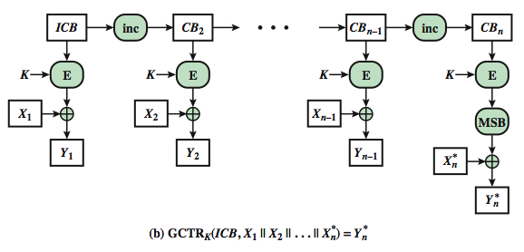
GCM Functions
Notes:
GCTR_{K}(ICB, X) takes a input a secret key K and a bit string X arbitrary length and returns a ciphertext Y of bit length len(X). The function may be specified as as shown in Stallings Figure 12.10b. Here the inc₃₂(S) function increments the rightmost 32 bits of S by 1 mod 2³², and the remaining bits are unchanged. Note that the counter values can be quickly generated and that the encryption operations can be performed in parallel.

Slide 35
Digital Signatures must have the following properties:
  It must verify the author and date & time of signature
  It must authenticate message contents
  It must be verified by third parties to resolve disputes

Slide 36
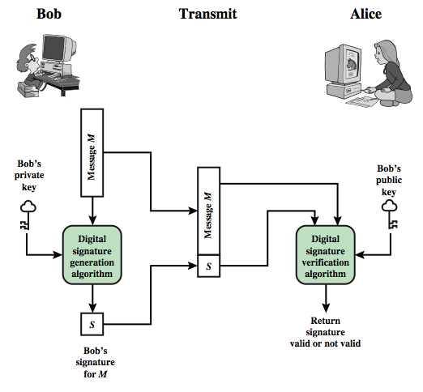
Generic Model of Digital Signature Process

Slide 37
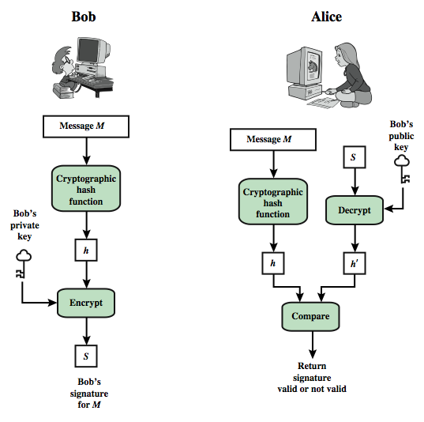
Essential Elements of Digital Signature Process

Slide 38
Digital Signature Standard:
    Developed by NIST
    Proposed in 1991
    Revised in 1993
    Further revision was made in 1996
    Expanded Version was introduced in 2000
    Two Approaches:
    1. RSA Approach
    2. DSS Approach

Slide 39
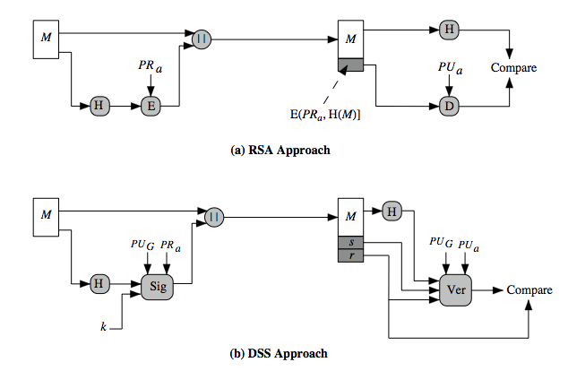
DSS vs RSA Signatures
Notes:
Stallings Figure 13.3 contrasts the DSS approach for generating digital signatures to that used with RSA. In the RSA approach, the message to be signed is input to a hash function that produces a secure hash code of fixed length. This hash code is then encrypted using the sender's private key to form the signature. Both the message and the signature are then transmitted. The recipient takes the message and produces a hash code. The recipient also decrypts the signature using the sender's public key. If the calculated hash code matches the decrypted signature, the signature is accepted as valid. Because only the sender knows the private key, only the sender could have produced a valid signature. The DSS approach also makes use of a hash function. The hash code is provided as input to a signature function along with a random number k generated for this particular signature. The signature function also depends on the sender's private key (PR _{a}) and a set of parameters known to a group of communicating principals. We can consider this set to constitute a global public key (PU_{G}). The result is a signature consisting of two components, labeled s and r. At the receiving end, the hash code of the incoming message is generated. This plus the signature is input to a verification function. The verification function also depends on the global public key as well as the sender's public key (PU_{a}), which is paired with the sender's private key. The output of the verification function is a value that is equal to the signature component r if the signature is valid. The signature function is such that only the sender, with knowledge of the private key, could have produced the valid signature.

Slide 40
DSA Key Generation
have shared global public key values (p,q,g):
  choose 160-bit prime number q
  choose a large prime p with 2^{L-1} < p < 2^{L}
    where L= 512 to 1024 bits and is a multiple of 64
    such that q is a 160 bit prime divisor of (p-1)
  choose g = h^{(p-1)/q} mod p
    where 1<h<p-1 and h^{(p-1)/q} mod p > 1
users choose private & compute public key:
  choose random private key: x<q
  compute public key: y = g^{x} mod p
Notes:
DSA typically uses a common set of global parameters (p,q,g) for a community of clients, as shown. A 160-bit prime number q is chosen. Next, a prime number p is selected with a length between 512 and 1024 bits such that q divides (p – 1). Finally, g is chosen to be of the form h^{(p–1)/q} mod p where h is an integer between 1 and (p – 1) with the restriction that g must be greater than 1. Thus, the global public key components of DSA have the same for as in the Schnorr signature scheme.
Then each DSA uses chooses a random private key x, and computes their public key as shown. The calculation of the public key y given x is relatively straightforward. However, given the public key y, it is computationally infeasible to determine x, which is the discrete logarithm of y to base g, mod p.

Slide 41
DSA Signature Creation
  r = (g^{k} mod p)mod q
  s = [k⁻¹(H(M)+ xr)] mod q
sends signature (r,s) with message M
Notes:
To create a signature, a user calculates two quantities, r and s, that are functions of the public key components (p,q,g), the user’s private key (x), the hash code of the message H(M), and an additional integer k that should be generated randomly or pseudo-randomly and be unique for each signing. This is similar to ElGamal signatures, with the use of a per message temporary signature key k, but doing calculations first mod p, then mod q to reduce the size of the result. The signature (r,s) is then sent with the message to the recipient. Note that computing r only involves calculation mod p and does not depend on message, hence can be done in advance. Similarly with randomly choosing k’s and computing their inverses.

Slide 42
DSA Signature Verification
having received M & signature (r,s)
to verify a signature, recipient computes:
  w = s⁻¹ mod q
  u1= [H(M)w ]mod q
  u2= (rw)mod q
  v = [(g^{u1} y^{u2})mod p ]mod q
if v=r then signature is verified
Notes:
At the receiving end, verification is performed using the formulas shown. The receiver generates a quantity v that is a function of the public key components, the sender’s public key, and the hash of the incoming message. If this quantity matches the r component of the signature, then the signature is validated. Note that the difficulty of computing discrete logs is why it is infeasible for an opponent to recover k from r, or x from s. Note also that nearly all the calculations are mod q, and hence are much faster save for the last step.
The structure of this function is such that the receiver can recover r using the incoming message and signature, the public key of the user, and the global public key. It is certainly not obvious that such a scheme would work. A proof is provided in Stallings appendix K.

Slide 43
ElGamal Digital Signatures
uses private key for encryption (signing)
uses public key for decryption (verification)
Each user (eg. A) generates their key
  chooses a secret key (number): 1 < x_{A} < q-1
  compute their public key: y_{A} = α^{xA} mod q
Notes:
Recall from Chapter 10, that in 1984, T. Elgamal announced a public-key scheme based on discrete logarithms, closely related to the Diffie-Hellman technique [ELGA84, ELGA85]. The ElGamal encryption scheme is designed to enable encryption by a user's public key with decryption by the user's private key. The ElGamal signature scheme involves the use of the private key for encryption and the public key for decryption. The ElGamal cryptosystem is used in some form in a number of standards including the digital signature standard (DSS) and the S/MIME email standard. As with Diffie-Hellman, the global elements of ElGamal are a prime number q and a, which is a primitive root of q. User A generates a private/public key pair as shown. The security of ElGamal is based on the difficulty of computing discrete logarithms, to recover either x given y, or k given K (next slide).

Slide 44
ElGamal Digital Signature
Alice signs a message M to Bob by computing
  the hash m = H(M), 0 <= m <= (q-1)
  1. Choose random integer K with 1 <= K <= (q-1) and gcd(K,q-1)=1
  2. Compute temporary key: S₁ = α^{k} mod q
  3.Compute K⁻¹ the inverse of K mod (q-1)
  4. Compute the value: S₂ = K⁻¹(m-x_{A}S₁) mod (q-1)
  5.signature is:(S₁,S₂)
Any user B can verify the signature by computing
  V₁ = α^{m} mod q
  V₂ = y_{A}^{S1} S₁^{S2} mod q
  signature is valid if V₁ = V₂
Notes:
To sign a message M, user A first computes the hash m = H(M), such that m is an integer in the range 0 <= m <= q – 1. A then forms a digital signature as shown.
The basic idea with El Gamal signatures is to again choose a temporary random signing key, protect it, then use it solve the specified equation on the hash of the message to create the signature (in 2 pieces). Verification consists of confirming the validation equation that relates the signature to the (hash of the) message (see text for proof). Again note that El Gamal encryption involves 1 modulo exponentiation and multiplications (vs 1 exponentiation for RSA).

Slide 45
X_{A} =16
α =10 q=19
Y_{A}= 4
m=14
K=5 (relatively prime to q-1)
S1= α^{K} mod q = 3
K⁻¹ = 11
S2= 11(14-16x3) mod 18 = 4
V1=16
V2=16

Slide 46
Schnorr Digital Signatures
Notes:
As with the ElGamal digital signature scheme, the Schnorr signature scheme is based on discrete logarithms [SCHN89, SCHN91]. The Schnorr scheme minimizes the message dependent amount of computation required to generate a signature. The main work for signature generation does not depend on the message and can be done during the idle time of the processor. The message dependent part of the signature generation requires multiplying a 2n-bit integer with an n-bit integer. The scheme is based on using a prime modulus p, with p – 1 having a prime factor q of appropriate size; that is p – 1 = 1 (mod q). Typically, we use p approx 2¹⁰²⁴ and q approx 2¹⁶⁰. Thus, p is a 1024-bit number and q is a 160-bit number, which is also the length of the SHA-1 hash value.

Slide 47
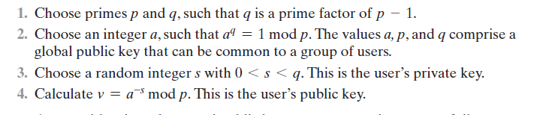
SASTRA DEEMED To Be UNIVERSITY

Slide 48
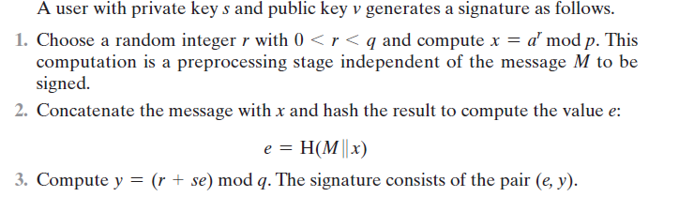
SASTRA DEEMED To Be UNIVERSITY

Slide 49
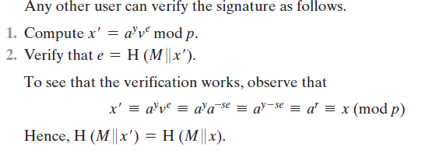
SASTRA DEEMED To Be UNIVERSITY

